Slide 1

Implementing Privacy-Preserving Techniques for Secure Healthcare Data Analytics
PRESENTED BY :
GUIDED BY :
S.Anushma(923822104006)
M.Sathya Jyothi(923822104043) M.Subhashree(923822104050) C.Swetha(923822104052)
Guide Name : Dr.R.Neelaveni
CSE & AIML (AP/AC)
Department / Programme:
CSE/BE
Semester/Year
: 8th SEM/4th YEAR
10-03-2026
DEPARTMENT OF CSE
1

Slide 2
Objectives
The main objective of this project is to develop a privacy-preserving healthcare data analytics framework that allows multiple hospitals to securely share and analyze medical data while protecting sensitive patient information. Healthcare datasets contain confidential details such as patient records, diagnosis information, and treatment history, which must be protected during storage, transmission, and analysis. To achieve this, the system implements a two-level security mechanism using Denoising Autoencoder and Adaptive Transform Level Fusion encryption to protect both the structural and statistical properties of the data. Through this approach, hospitals can share encrypted datasets with a central server where secure data fusion and machine learning analytics can be performed without revealing the original patient information, ensuring both effective healthcare analytics and strong patient data privacy.
10-03-2026
DEPARTMENT OF CSE
2

Slide 3
Existing System
In traditional healthcare data analytics systems, datasets from different hospitals are collected and stored in a centralized server for analysis. These systems often rely on basic encryption techniques or simple data protection methods. However, during data sharing and analytics processes, sensitive patient information may still be exposed. Existing systems usually provide single-layer security, which is not sufficient to prevent statistical attacks or pattern-based data leakage. Additionally, these systems do not effectively hide the structural relationships within the datasets, making them vulnerable to privacy breaches. As a result, there is a need for a more advanced privacy-preserving framework that can secure healthcare data while still enabling effective analytics.the centralized storage of large-scale healthcare data increases the risk of unauthorized access and data misuse. If the central server is compromised, the entire dataset containing confidential patient information may be exposed.
10-03-2026
DEPARTMENT OF CSE
3

Slide 4
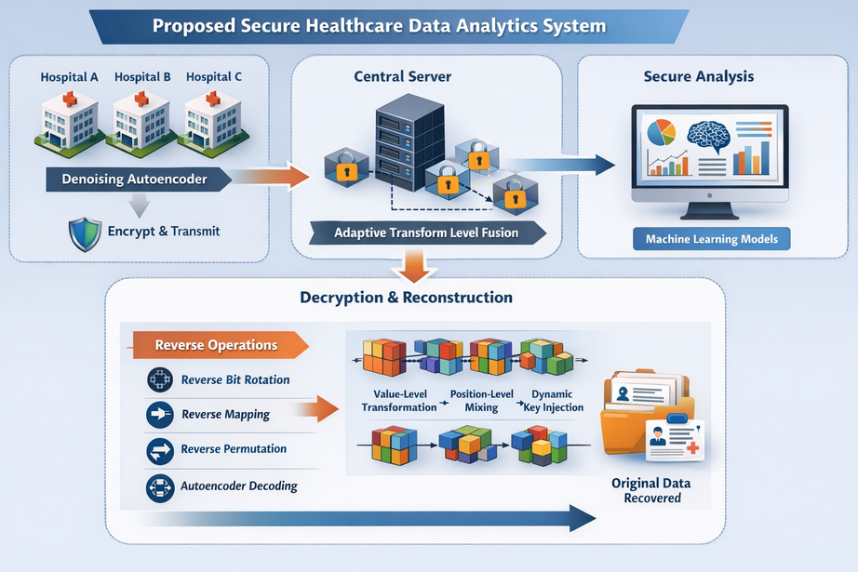
Proposed System
The proposed system introduces a two-level privacy-preserving architecture for secure healthcare data analytics across multiple hospitals. In the first level, each hospital processes its dataset using a Denoising Autoencoder, which removes noise and encodes the dataset into a latent representation, providing structural protection. The encoded data is then encrypted and transmitted securely to a central server. In the second level, encrypted datasets from different hospitals are combined using Adaptive Transform Level Fusion, which applies value-level transformation, position-level mixing, and dynamic key injection to enhance security. During data retrieval, the system performs decryption using reverse operations such as reverse bit rotation, reverse nonlinear mapping, reverse permutation, and autoencoder decoding. This dual-layer approach ensures high data privacy while enabling secure machine learning analytics.
10-03-2026
DEPARTMENT OF CSE
4

Slide 5
System Requirements
Hardware Requirements
The system requires a computer with a minimum Intel i5 or equivalent processor, 8 GB RAM, and sufficient storage capacity such as 256 GB SSD to handle dataset processing and machine learning computations.
Software Requirements
The software environment includes Python programming language for implementing machine learning models and encryption algorithms. Development tools such as Jupyter Notebook or Visual Studio Code are used for coding and experimentation. Libraries such as TensorFlow, NumPy, Pandas, Scikit-learn, and Matplotlib are used for data processing, model development, and visualization.
10-03-2026
DEPARTMENT OF CSE
5

Slide 6
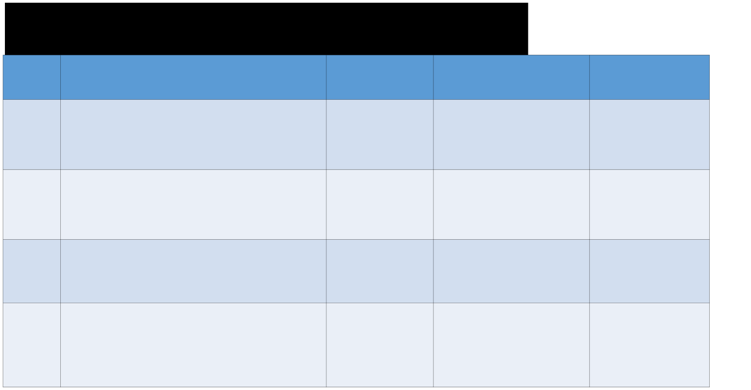
Literature Survey
S.No
TITLE
AUTHOR(S)
INFERENCE
PUBLISHED IN
Privacy Preservation In Artificial Intelligence - Enabled Healthcare Analytics
Shancang Li1* , Muddesar Iqbal2 , Ali Kashif Bashir3,5,6 and Xinheng Wang4
privacy-preserving methods improve secure data storage and controlled access in healthcare systems.
RESEARCH (Research Manuscript) Open Access
1.
encryption-based privacy techniques can securely enable healthcare data analysis without compromising patient confidentiality
Journal of Recent Trends in Computer Science and Engineering (JRTCSE)
2.
Privacy - Preserving AI For Secure Data Sharing In Healthcare
Rajashekhar Reddy Kethireddy
encrypted data can be effectively
used in advanced machine learning
models while maintaining high
privacy and accuracy.
Al Amin
∗ , Kamrul Hasan∗
University of Central Arkansas, Conway, AR, USA
3.
AI- Driven Secure Data Sharing: A Trustworthy And Privacy - Preserving Approach
, Sharif Ullah† , Liang
Hong
∗ ∗Tennessee State
University, TN, USA
Alejandro Guerra-
combining security mechanisms with machine learning enhances reliable and safe healthcare
Privacy-Preserving Machine Learning For Healthcare: Open Challenges And Future
Manzanares
ICLR 2023 Workshop on Trustworthy Machine
∗ , L. Julian
4.
Lechuga Lopez ,
∗
Perspectives
Michail Maniatakos
Learning for
andFarah E.Shamout
predictions.

Slide 7
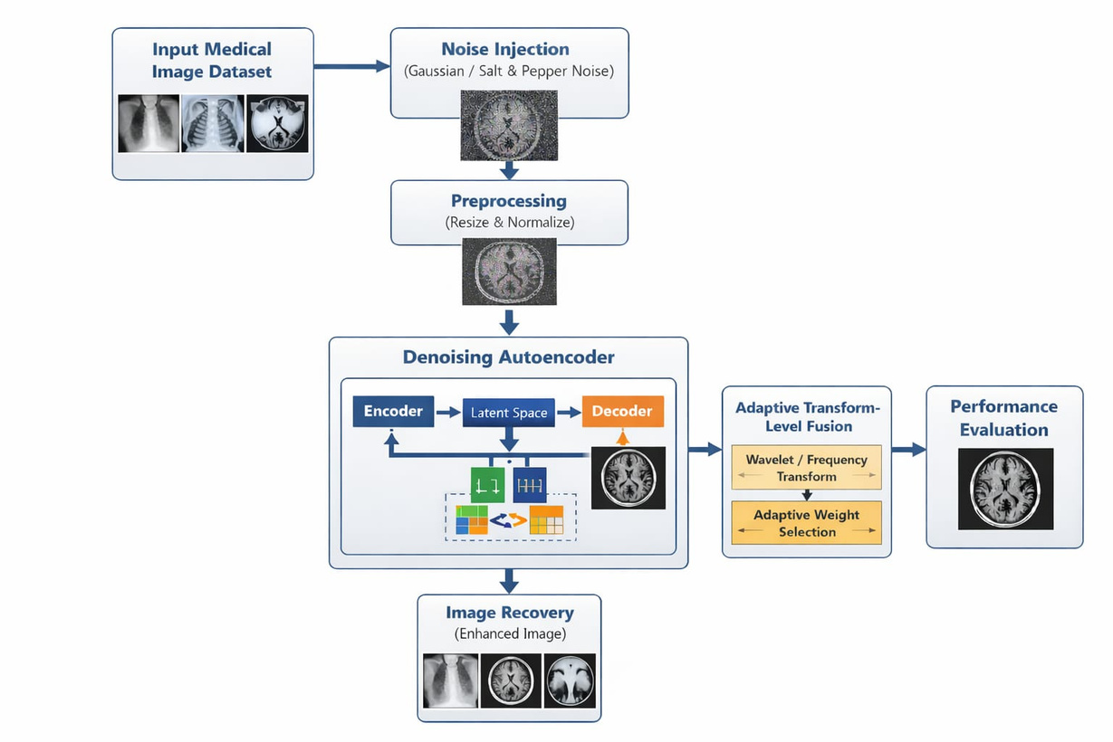
Architecture Diagram:
10-03-2026
DEPARTMENT OF CSE
7

Slide 8
Modules Completed
1. Data Collection Module ( COMPLETED)
Healthcare datasets are collected from multiple hospitals for secure analytics.
2. Denoising Autoencoder Module ( COMPLETED)
Each hospital processes its dataset using a Denoising Autoencoder to remove noise and generate a secure encoded representation.
3. Encryption Module ( COMPLETED)
The encoded data is encrypted to protect structural information before transmission.
4. Secure Data Transmission Module
Encrypted datasets are securely transmitted from individual hospitals to the central server.
5. Adaptive Transform Level Fusion Module
Encrypted datasets from different hospitals are fused using adaptive transform level fusion techniques.
6. Decryption and Reconstruction Module
The encrypted dataset is decrypted using reverse operations, and the Autoencoder decoder reconstructs the data for further analytics.
10-03-2026
DEPARTMENT OF CSE
9

Slide 9

Work Plan & Timeline
Phase
Activities
Duration
Phase
Activities
Problem Definition & Literature Survey
Identifying privacy issues in healthcare data sharing and studying existing research works.
Phase 1
2 weeks
Phase 1
Datasett collection and model development
Collecting healthcare datasets and implementing the Denoising Autoencoder model for data encoding.
Phase 2
4 weeks
Phase 2
Encyption And Data Fusion Implementation
Applying encryption techniques and performing Adaptive Transform Level Fusion to combine encrypted datasets securely.
Phase 3
4 weeks
Phase 3
Reconstructing the dataset using the decoder, evaluating security performance, and preparing the final report and presentation.
Phase 4
Decryption,
Evaluation ,and documentation
1 weeks
Phase 4
10-03-2026
DEPARTMENT OF CSE
8

Slide 10
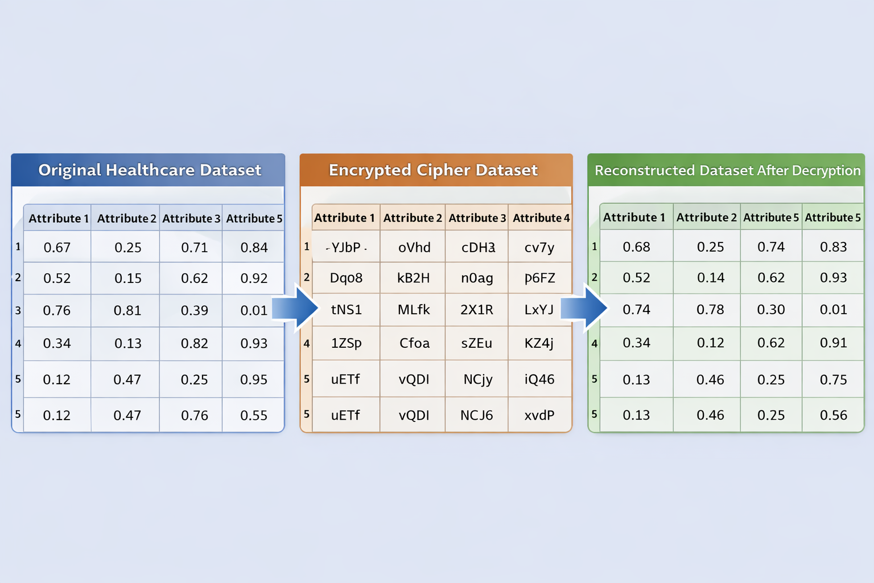
Output
10-03-2026
DEPARTMENT OF CSE
10

Slide 11
Conclusion
This project works on secure dataset processing to improve the quality and reliability of data.
The Denoising Autoencoder helps remove noise from the dataset and produces a cleaner output.
The Adaptive Transform-Level Fusion method enhances important information and improves the final result.
The proposed system helps maintain data security and integrity while processing the dataset.
Overall, the system produces a better quality and more secure output dataset, which can be useful for further analysis and applications.
10-03-2026
DEPARTMENT OF CSE
11

Slide 12
Future Work
The proposed system can be extended to work with larger and more diverse datasets to improve performance and reliability.
Advanced deep learning models can be integrated to further enhance noise removal and feature extraction.
The system can be improved to support real-time data processing for faster and more efficient results.
Additional security techniques and encryption methods can be incorporated to provide stronger protection for sensitive datasets.
Future research can focus on optimizing computational efficiency to reduce processing time and resource usage.
10-03-2026
DEPARTMENT OF CSE
12

Slide 13
THANK YOU
10-03-2026
DEPARTMENT OF CSE
13

